Slide 1

FINDING A NEW HOME
A MIAMI NEIGHBORHOODS ANALYSIS TO IDENTIFY THE BEST NEIGHBORHOOD FOR A BISTRO BRANCH

Slide 2
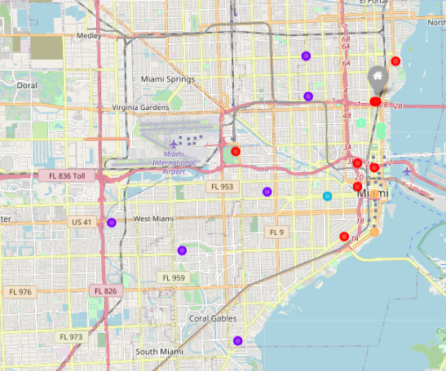
THE BISTRO
My theoretical bistro is called Mandau Bistro, and it’s located in the Designers district neighborhood, in Miami, FL;
In this exercise, the bistro is constantly busy and now needs to open a new branch in the city, in order to be able to keep serving its audience;
Current bistro is the Gray-Home dot in the map.

Slide 3
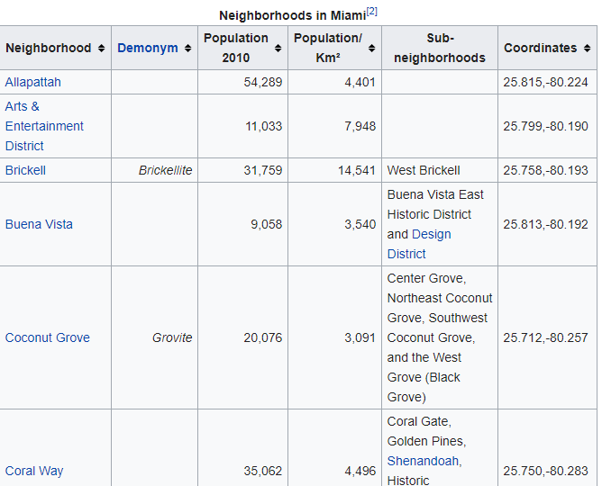
THE DATA
In order to achieve this analysis, following data will be used:
Foursquare API: with that, it will be possible to analyze the types of venues in each neighborhood;
List of Miami Neighborhoods: with that list, it’s possible to locate the neighborhoods geographically and even cluster them by it’s population and density.

Slide 4
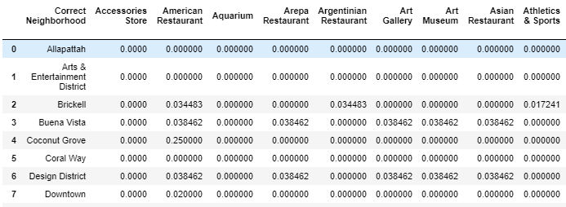
THE METHODOLOGY
Data from Wikipedia and Foursquare API will be processed using Pandas library in Python;
With the dataframe well prepared, we will be able to cluster the neighborhoods using the K-Means algorithm.

Slide 5
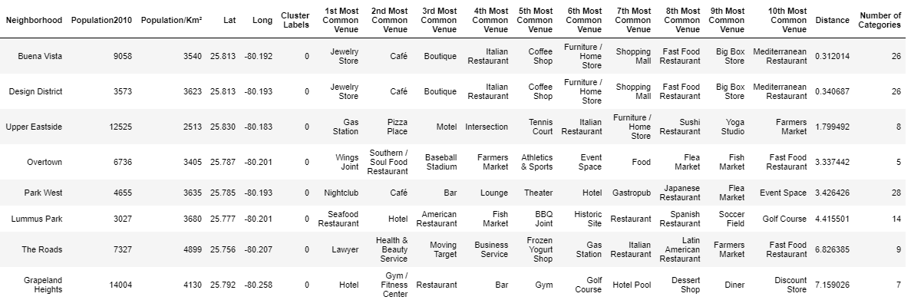
THE RESULTS – CLUSTER 0
More nightlife neighborhood. This is our cluster of interest.

Slide 6
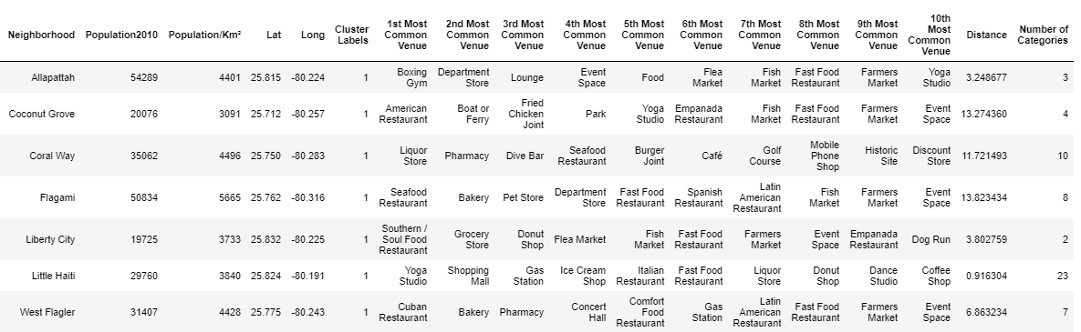
THE RESULTS – CLUSTER 1
Based on restaurants, this cluster has few venues and high population, what shows us a residential cluster.

Slide 7
THE RESULTS – CLUSTER 2
Another residential neighborhood, it’s based only on Little Havana neighborhood.

Slide 8
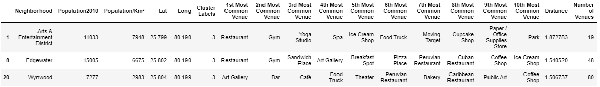
THE RESULTS – CLUSTER 3
It has restaurants, but also different venues as Gyms, Yoga Studio and Art Galleries.

Slide 9
THE RESULTS – CLUSTER 4
Hotel cluster with some cafes and restaurants.

Slide 10
DISCUSSION
As it’s the more distant neighborhood from the actual local on Cluster 0, Grapeland Heights shows the best option in a first view.
However, it’s important to note that further analysis, subjective one, are needed now to decide:
Is this neighborhood socialeconomic distribution similar to the Design district?
Is housing price so expensive that it would make it not worth to open a bistro on it?

